Slide 1
Intro to Transformers
IAC Deep Learning Course

Slide 2
The Revolutionary Paper
Attention is all you need
Tensor2Tensor repository
The annotated paper

Slide 3

Transformer is
Faster
Parallelizable

Slide 4

Let’s Open up the Optimus Prime
Ops! Not Him

Slide 5

Let’s Open up the Optimus Prime

Slide 6

Let’s Open up the Optimus Prime

Slide 7
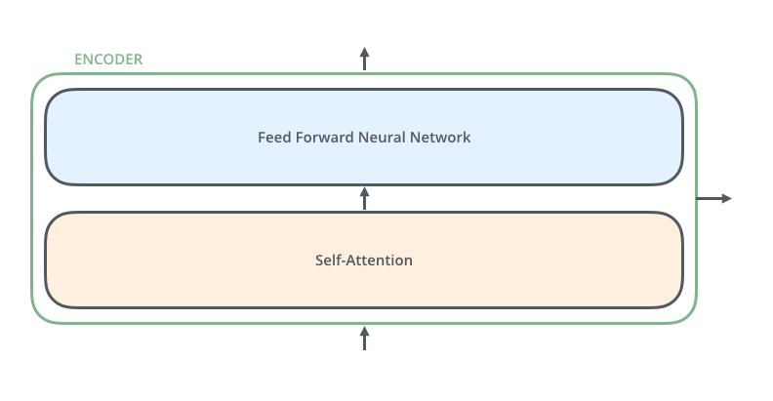
Inside the Encoder

Slide 8

Inside the Encoder-Decoder

Slide 9
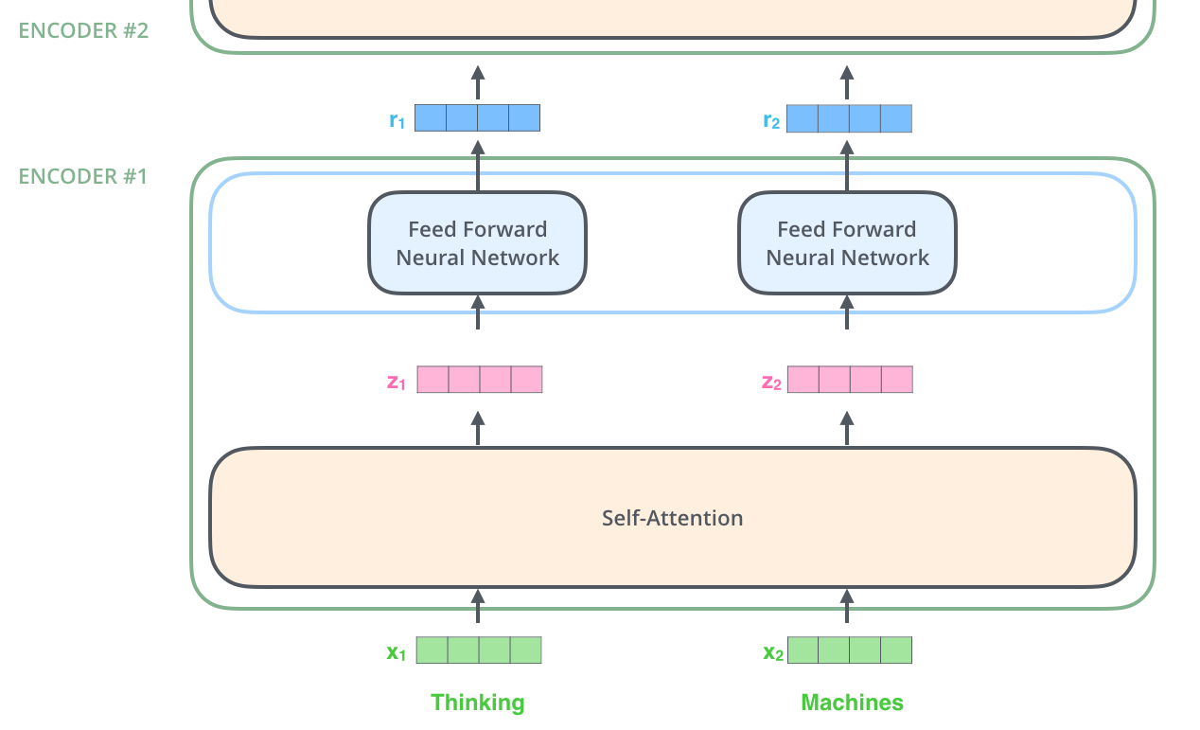
The pipeline

Slide 10

Self Attention

Slide 11

Self Attention

Slide 12
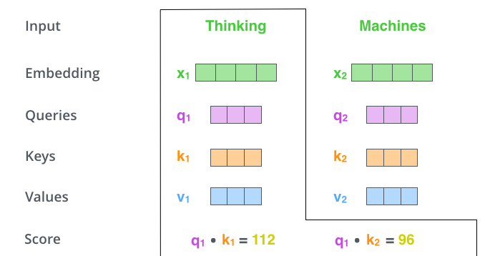
Self Attention

Slide 13

Self Attention

Slide 14
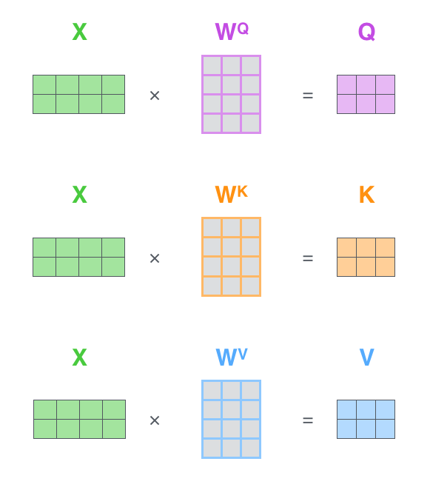
Self Attention

Slide 15

Self Attention

Slide 16
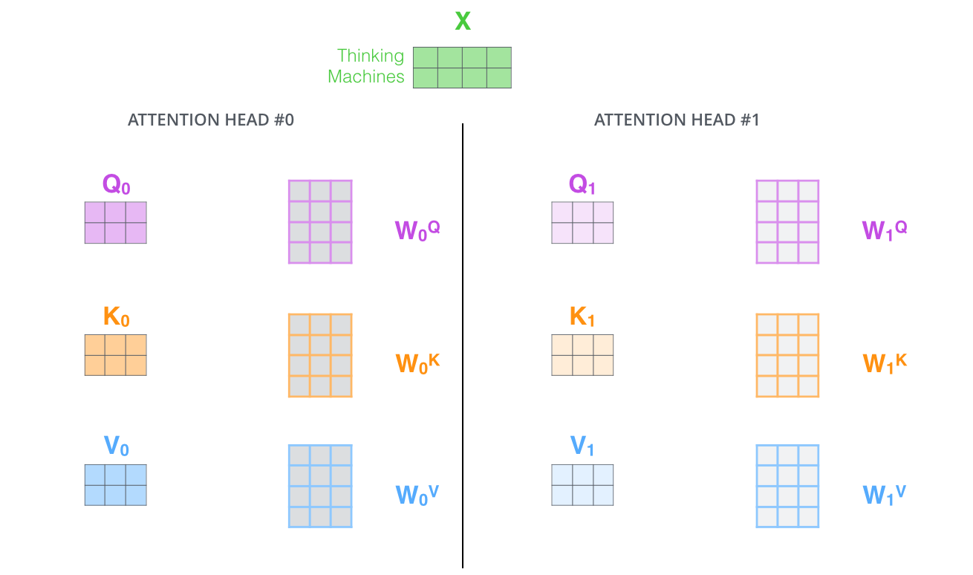
Self Attention

Slide 17
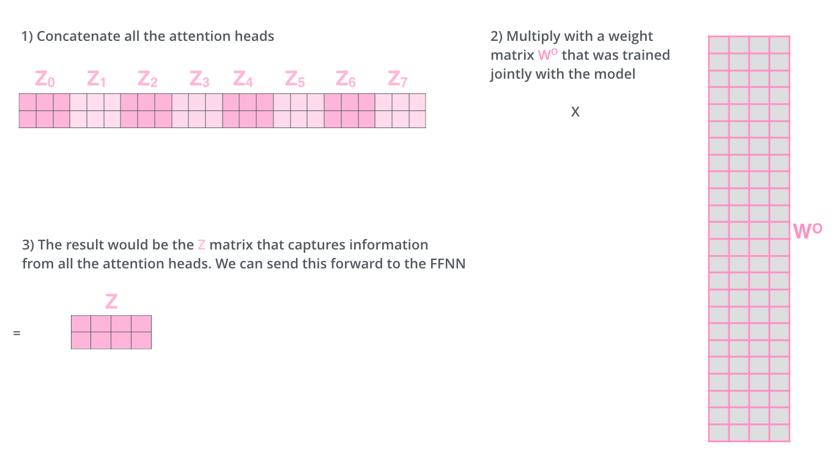
Self Attention

Slide 18

Self Attention

Slide 19
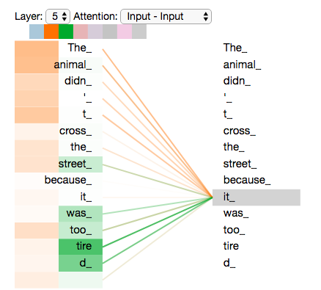
Self Attention

Slide 20
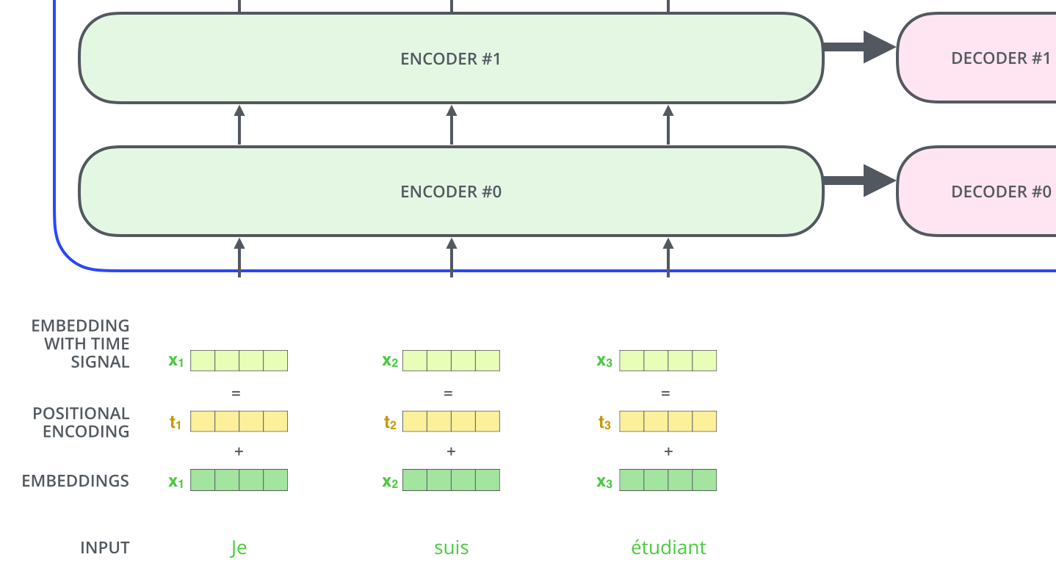
Positional Encoding

Slide 21

Decoder

Slide 22

Decoder

Slide 23
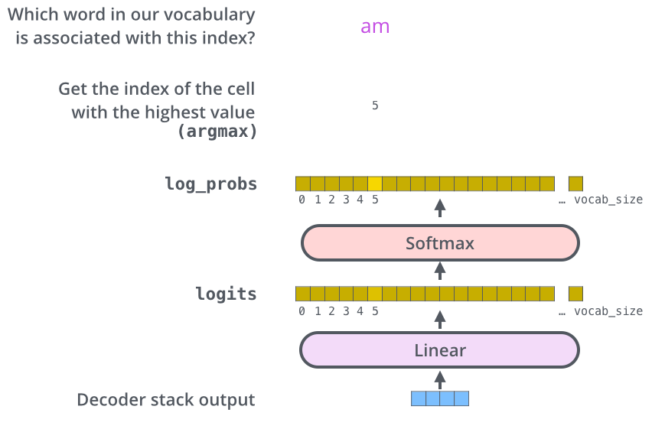
Output

Slide 24
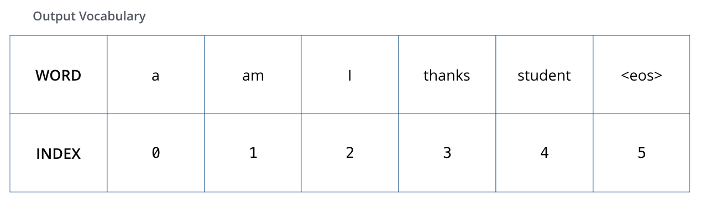
Loss Calculation

Slide 25
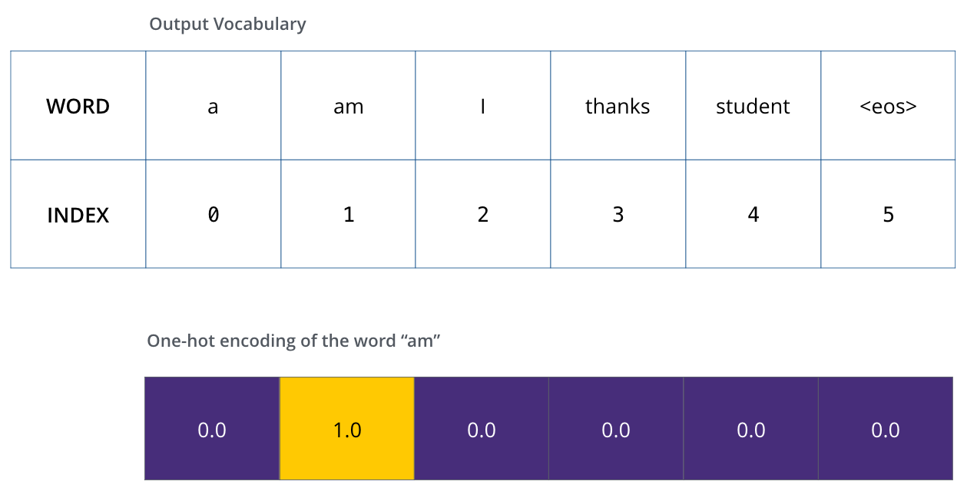
Loss Calculation

Slide 26
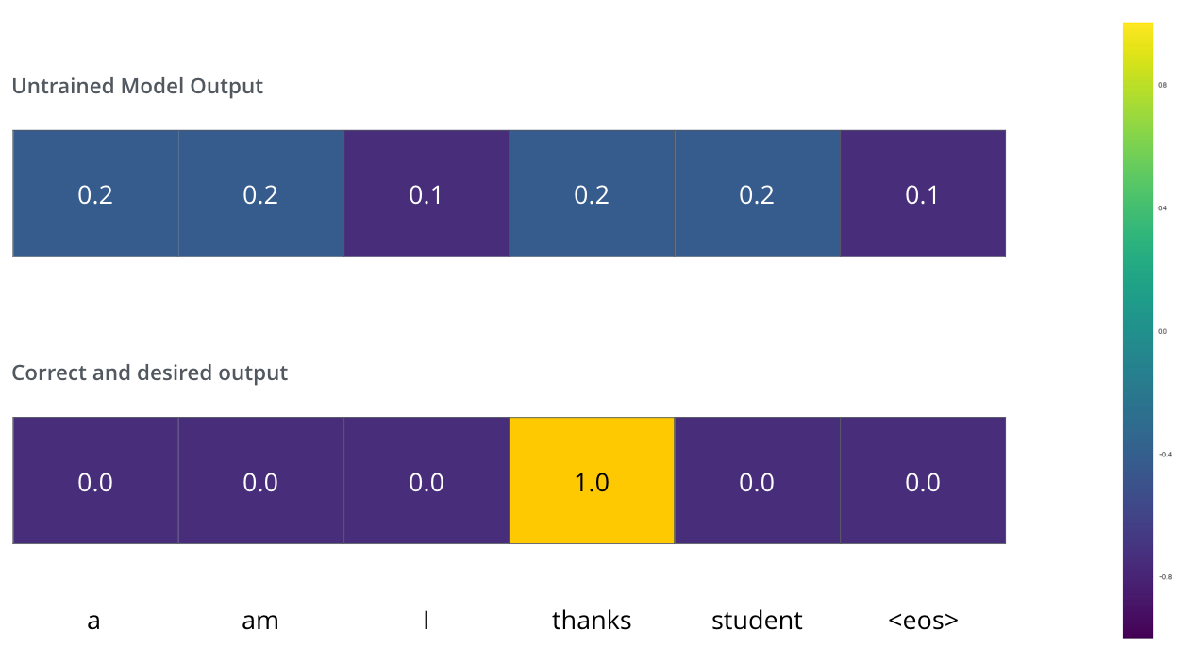
Loss Calculation

Slide 27
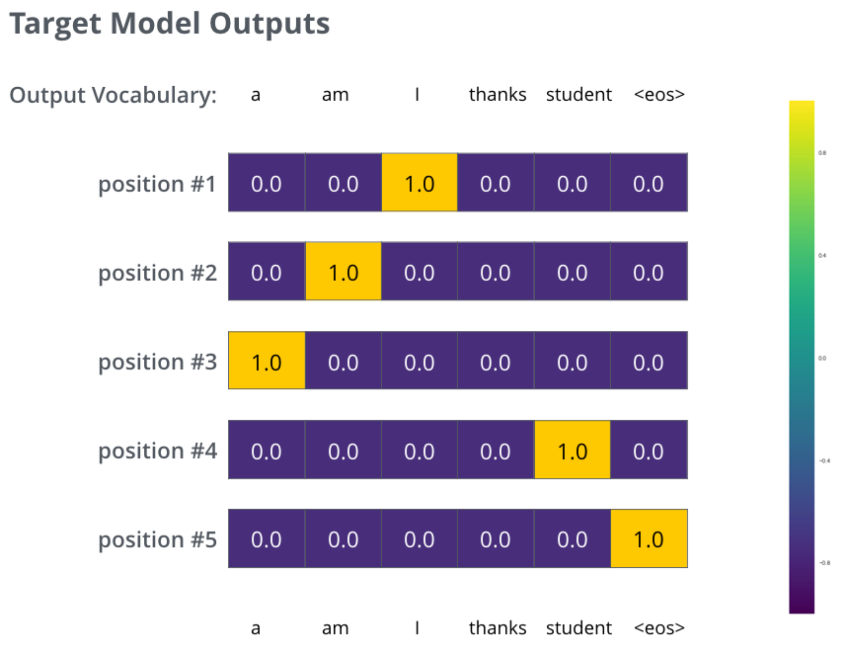
Loss Calculation

Slide 28
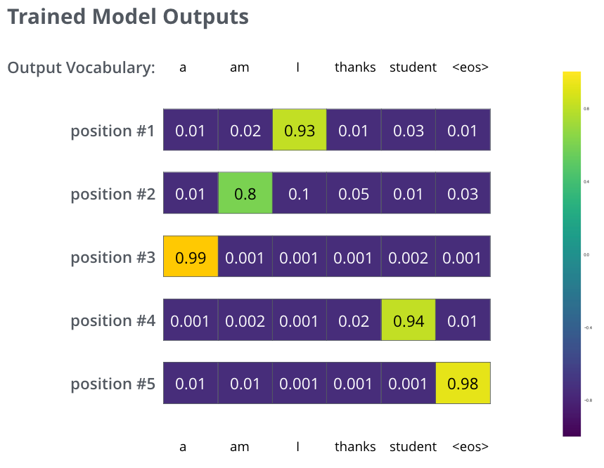
Loss Calculation

